Slide 1
Detection of Phishing Websites using feature extraction and machine learning techniques.
Btech CSE 2024
By
Shubham Mandal

Slide 2
Introduction
On the era of internet cybercrimes has been incresed by many folds making it more vulnerable to data stealing and leaking of credentials for the solution of which i made an Supervised machine learning model using very well known Algorithmns comparing the common malpractices defined as features and result the output as in the terms of Accuracy and Performance

Slide 3
Literature Review
For this project in particular i had studied the recent records of cyber crime and reviewed few articles regarding the same from the site of university of burnswick and the other reports from NullByte and phishtank.

Slide 4
Methodology
Collected dataset containing phishing and legitimate websites from the open source platforms.
Wrote a code to extract the required features from the URL database.
Divide the dataset into training and testing sets.
Run selected machine learning and deep neural network algorithms like SVM, Random Forest,Autoencoder on the dataset.
Wrote a code for displaying the evaluation result considering accuracy metrics.
Compare the obtained results for trained models and specify which is better.

Slide 5
Data Collection
Legitimate URLs are collected from the dataset provided by University of New Brunswick, https://www.unb.ca/cic/datasets/url-2016.html.
From the collection, 5000 URLs are being randomly picked.
Phishing URLs are collected from opensource service called PhishTank . This service provide a set of phishing URLs in multiple formats like csv, json etc that gets updated hourly.
Form the obtained collection, 5000 URLs are being randomly picked.

Slide 6
Feature Selection
The following category of features are selected:
Address Bar based Features considered are:
Domian of URL - Redirection ‘//’ in URL
IP Address in URL -‘http/https’ in Domain name
‘@’ Symbol in URL - Using URL Shortening Service
Length of URL -Prefix or Suffix "-" in Domain
Depth of URL

Slide 7
Domain based Features considered are:
DNS Record
Age of Domain
Website Traffic
End Period of Domain

Slide 8
HTML and JavaScript based Features considered are:
Iframe Redirection
Disabling Right Click
Status Bar Customization
Website Forwarding

Slide 9
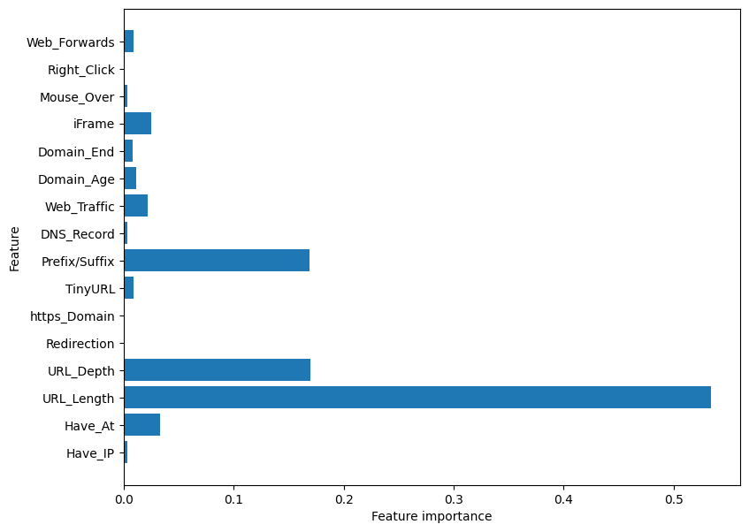

Slide 10
Machine Learning Models
This is a supervised machine learning task. There are two major types of supervised machine learning problems, called classification and regression.
This data set comes under classification problem, as the input URL is classified as Phishing or Legitimate The machine learning models (classification) considered to train the dataset in this notebook are:
Decision Tree
Random Forest
Multilayer Perceptrons
XGBoost
Autoencoder Neural Network
Support Vector Machines

Slide 11
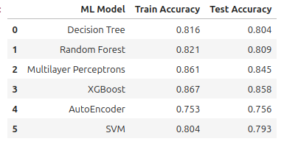
Model Evalution

Slide 12
Conclusion
In closing, this study demonstrates that combining machine learning with careful feature extraction offers a powerful tool to fight phishing attacks. By examining website characteristics like web addresses, content, and underlying code, machine learning models can be trained to identify fake websites. This approach is adaptable, allowing for the inclusion of new features and training on ever-changing phishing tactics. As online security remains a top priority, robust phishing detection systems powered by machine learning will be key to protecting users and creating a safer online environment.

